Slide 1
Speedometer in EV’s

Slide 2
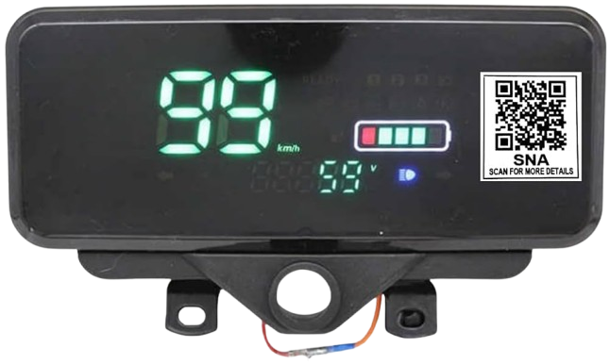
Speedometer
A speedometer is an instrument used to measure and display the speed of a vehicle, typically in miles per hour (mph) or kilometers per hour (km/h). It works by receiving data from the vehicle's transmission through a speed sensor or cable that measures the rotational speed of the wheels. In modern vehicles, electronic speedometers are common, which rely on a digital sensor to send signals to the speedometer, where the data is processed and displayed. Speedometers also often have an odometer function that tracks the total distance traveled by the vehicle.

Slide 3
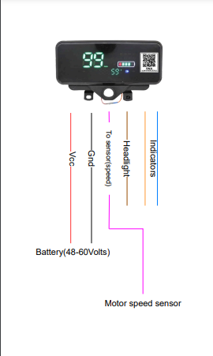
Wiring of Speedometer
Here’s typical wiring colors in an e-rickshaw’s speedometer system:
Red: Power supply to the speedometer
Black: Ground (earth connection)
Orange: Left indicator signal
-Blue: Right indicator signal
Brown: Headlight connection
Purple: Connection to motor speed sensor (for speed data)
Actual color coding may vary depending on the manufacturer and model of the e-rickshaw

Slide 4
Steps to test wires
1. Turn Off Vehicle Power: Ensure the vehicle is off before testing.
2. Use a DC Power Source: Use a power supply or the vehicle’s battery (12V/24V/48V).
3. Test Each Wire:
Red (Power): Apply power to check if the speedometer turns on.
Black (Ground): Connect the negative terminal to check for proper grounding.
Orange/Blue (Indicators): Apply power to each wire to test left/right indicators.
Brown (Headlight): Apply voltage to check if the headlight turns on.
-Purple (Speed Sensor): Do not apply power directly; check using a multimeter.
4. Observe the meter: Ensure each component functions properly when power is applied.

Slide 5
Speed sensor
In a BLDC motor, Hall-effect sensors detect the rotor's magnetic poles as it spins. These sensors generate pulses that indicate the rotor's position. The motor controller uses the frequency of these pulses to calculate the motor's speed (RPM). This data helps the controller adjust power and maintain smooth, efficient operation.
Odometer
Distance measurement in a BLDC motor system is achieved by calculating the wheel's circumference and using speed data from the Hall-effect sensors to determine how far the motor has driven the wheels based on the number of revolutions made.

Slide 6
State of charge
Voltage measurement is a useful method for estimating the State of Charge (SoC) of a battery. By understanding the voltage-to-SoC relationship and accounting for factors like temperature and load, this method can provide a reasonably accurate indication of the battery's charge level.

Slide 7
Thank You

